Slide 1



Sustainable Supply Chain Performance Dashboard in Power BI
Name : MRUDUL PARAG CHAUDHARI
Student ID : STU649aa936b0bfa1687857462
College: VIDYAVARDHINI'S COLLEGE OF ENGINEERING AND TECHNOLOGY

Slide 2

Learning Objectives
Understand key supply chain management concepts and their impact on business performance.
Learn how to leverage Power BI for data visualization and analytics.
Analyze real-world data to derive meaningful insights related to inventory, sales, and logistics.
Identify inefficiencies in supply chain processes and propose data-driven solutions.
GOAL
Source :
www.freepik.com/

Slide 3
Tools and Technology used
Power BI – Data visualization and reporting.
Power Query – Data cleaning and transformation.
DAX (Data Analysis Expressions) – Data modeling and calculations.
Excel/CSV – Data source for initial processing.
SQL (if applicable) – Data extraction and management.

Slide 4
Methodology
Data Understanding – Explore the dataset structure and key attributes.
Data Preparation – Clean and preprocess data using Power Query.
Data Analysis – Use DAX to perform calculations and generate insights.
Visualization – Develop interactive dashboards in Power BI.
Insights & Reporting – Interpret results and provide strategic recommendations.

Slide 5
Problem Statement:
Supply chain inefficiencies lead to delays, high costs, and low customer satisfaction.
Lack of real-time visibility into inventory, transportation, and sales performance.
Need for data-driven decision-making to improve profitability, logistics, and customer service.

Slide 6
Solution:
Developed a Power BI dashboard for real-time supply chain monitoring.
Identified the most profitable product categories (Skincare).
Analyzed transportation modes and preferred routes to optimize logistics.
Evaluated city-wise sales performance and revenue generation.
Assessed lead time and customer satisfaction levels for service improvement.

Slide 7
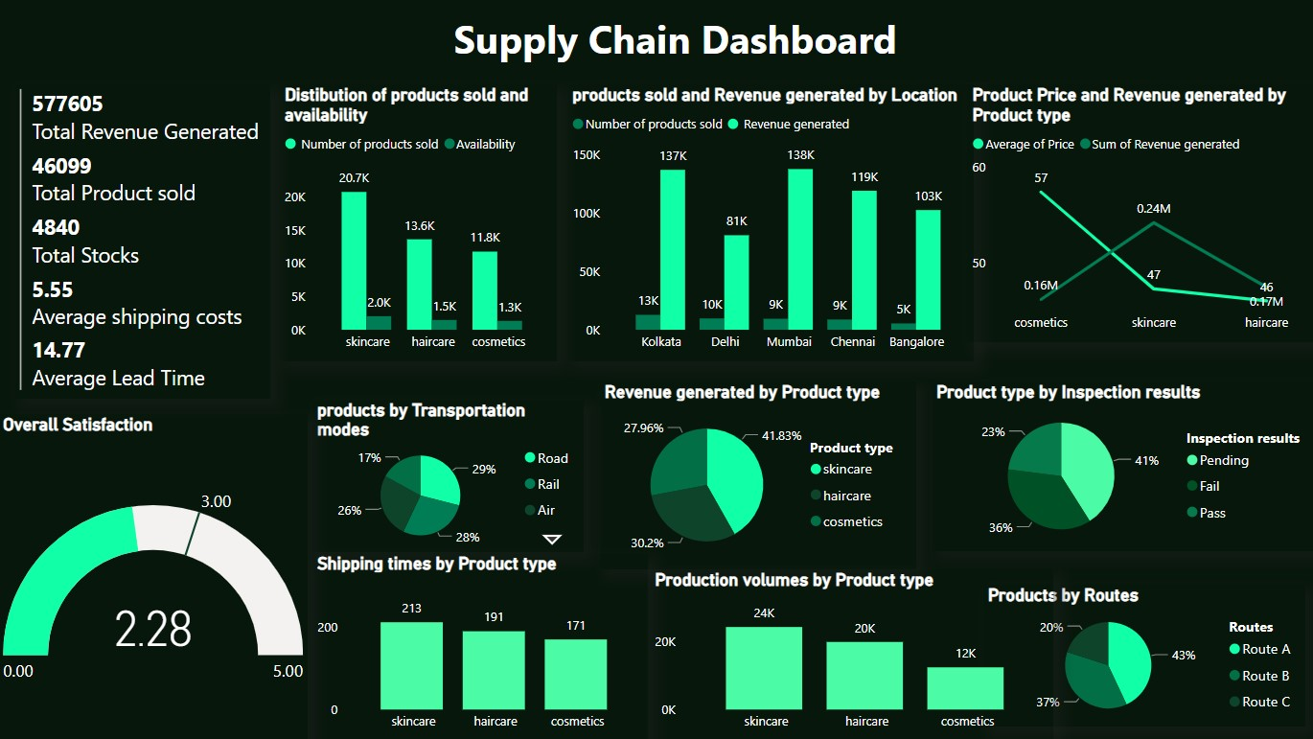
Screenshot of Output:

Slide 8
Conclusion:
Skincare emerged as the most profitable product category.
Roadways are the dominant mode of transport, with Route A being the most utilized.
Mumbai leads in revenue, while Kolkata records the highest sales volume.
Customer satisfaction is below the target (2.28 vs. 3.00), requiring service improvements.
Strategic recommendations include optimizing logistics, reducing lead time, and enhancing customer experience.

